Slide 1


3FE Restaurant Website: A Digital Feast
Welcome to the presentation outlining the development of the 3fe Restaurant website, a digital experience that will capture the essence of your establishment and provide a seamless journey for your patrons.
by Rahul Kamboj

Slide 2
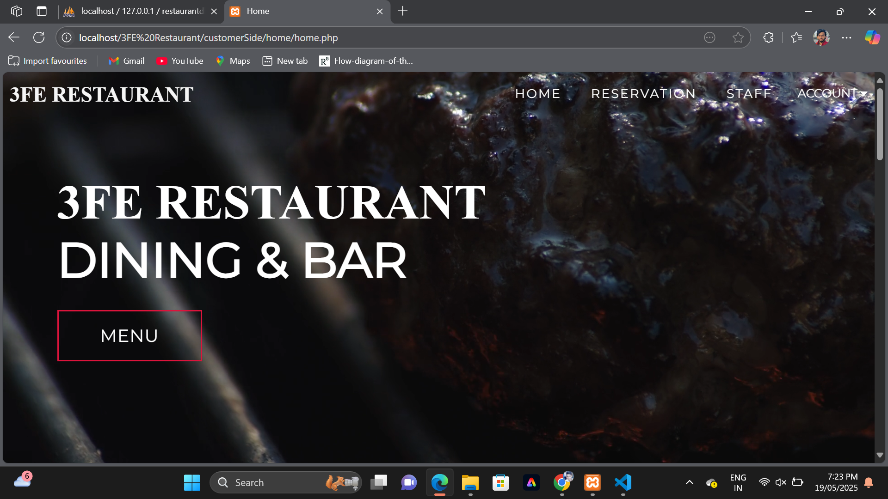
Home Page: Your Restaurant's Digital Welcome Mat
First Impressions Matter
The home page will be the first point of contact for potential customers, providing a visually appealing introduction to your restaurant's unique ambiance and culinary offerings.
Essential information, such as hours of operation, location, and contact details, will be prominently displayed to ensure convenient access for visitors.

Slide 3
Key Features: Enhancing the Dining Experience
Login & Sign-up
Reservation System
Menu Management
Securely manage user accounts, allowing customers to create profiles, save preferences, and access personalized features.
Enable online booking for tables, optimizing table management and providing convenience for customers.
Display a visually appealing menu with detailed descriptions and pricing, allowing customers to browse and select their desired dishes.
Order Placement
Billing & Payment
Offer online ordering for takeaway or delivery, streamlining the ordering process and enhancing customer convenience.
Integrate a secure payment gateway to facilitate online transactions, providing a smooth and reliable checkout experience.

Slide 4
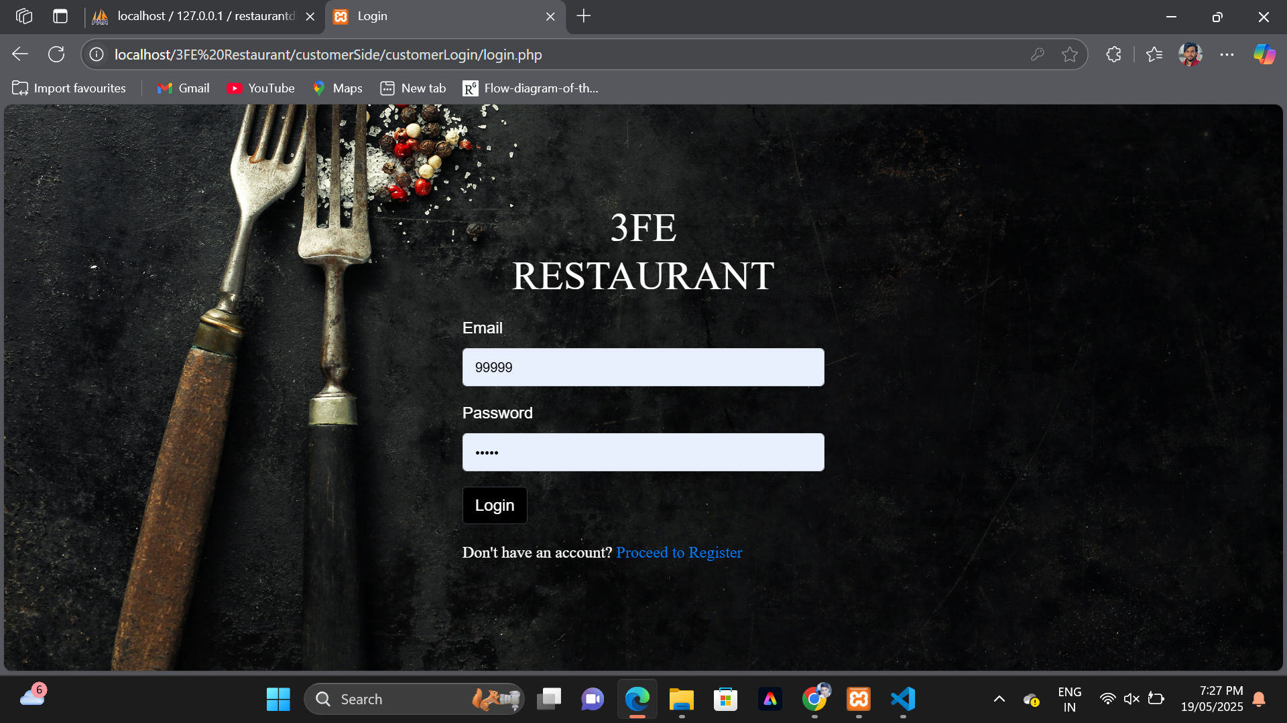
Login and Sign-Up: Personalized Access
1
User Accounts
2
Order History
3
Special Offers
Enable users to create accounts, securely store their information, and access personalized features.
Allow users to view their past orders, providing a convenient way to track their purchases and re-order favorites.
Send targeted promotions and exclusive deals to registered users, fostering customer loyalty and encouraging repeat visits.

Slide 5

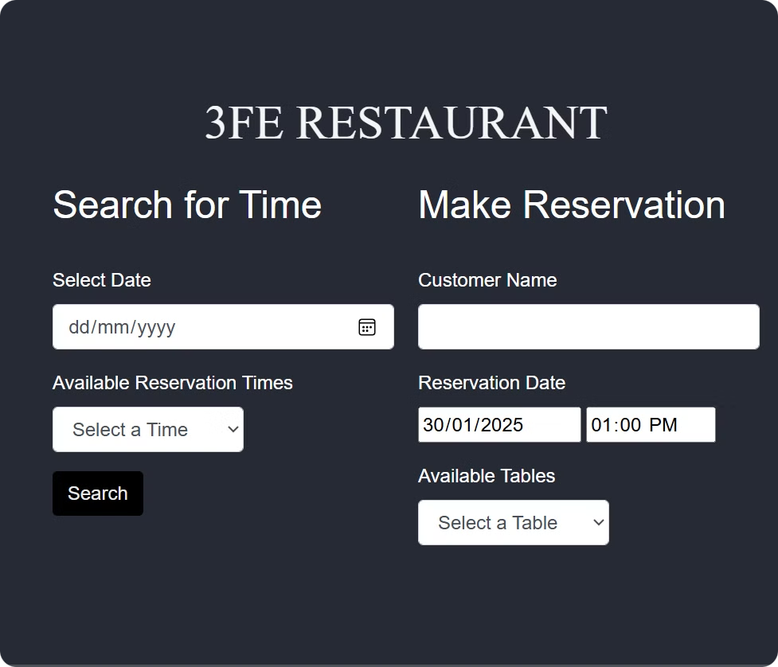
Reservation System: Seamless Table Booking
1
Calendar View
Provide an intuitive calendar interface for users to easily select their desired reservation date and time.
2
Table Selection
Offer a visual representation of available tables, allowing users to choose their preferred seating arrangement.
3
Confirmation & Reminders
Send instant reservation confirmations and automated reminders to ensure smooth booking and prevent missed reservations.

Slide 6



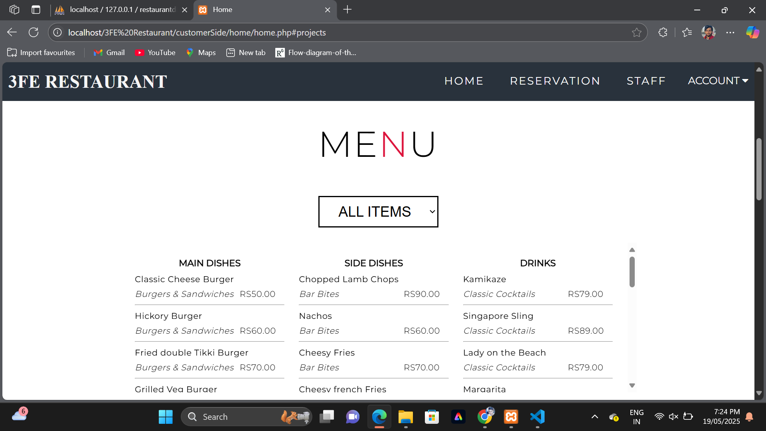

Menu Management: A Digital Showcase of Culinary Delights
Visually Appealing
Dietary Information
Showcase dishes with enticing images to entice customers and highlight their visual appeal.
Clearly indicate ingredients and potential allergens to cater to diverse dietary needs and preferences.
Pricing Transparency
Display clear and accurate pricing for each dish, ensuring transparency and providing customers with confidence.

Slide 7


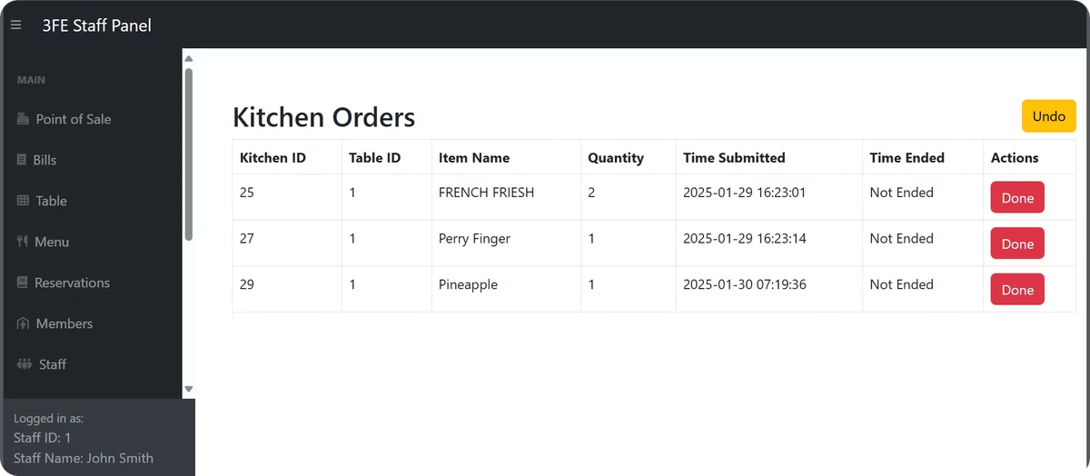


Order Placement: Streamlined Online Ordering
Item Selection
Enable users to easily browse the menu, select their desired items, and add them to their virtual shopping cart.
Quantity Adjustment
Allow users to adjust the quantity of each item in their cart, ensuring flexibility and accurate order placement.
Checkout & Payment
Provide a secure checkout process with integrated payment gateways, allowing users to complete their orders seamlessly.

Slide 8



Billing and Payment: Secure Transactions
Secure Payment Gateways
1
Encryption & Security
2
Ensure that all payment data is securely encrypted and protected, providing customers with peace of mind.
Transaction Confirmation
3
Provide instant order confirmation and payment receipts, ensuring transparency and accountability.

Slide 9
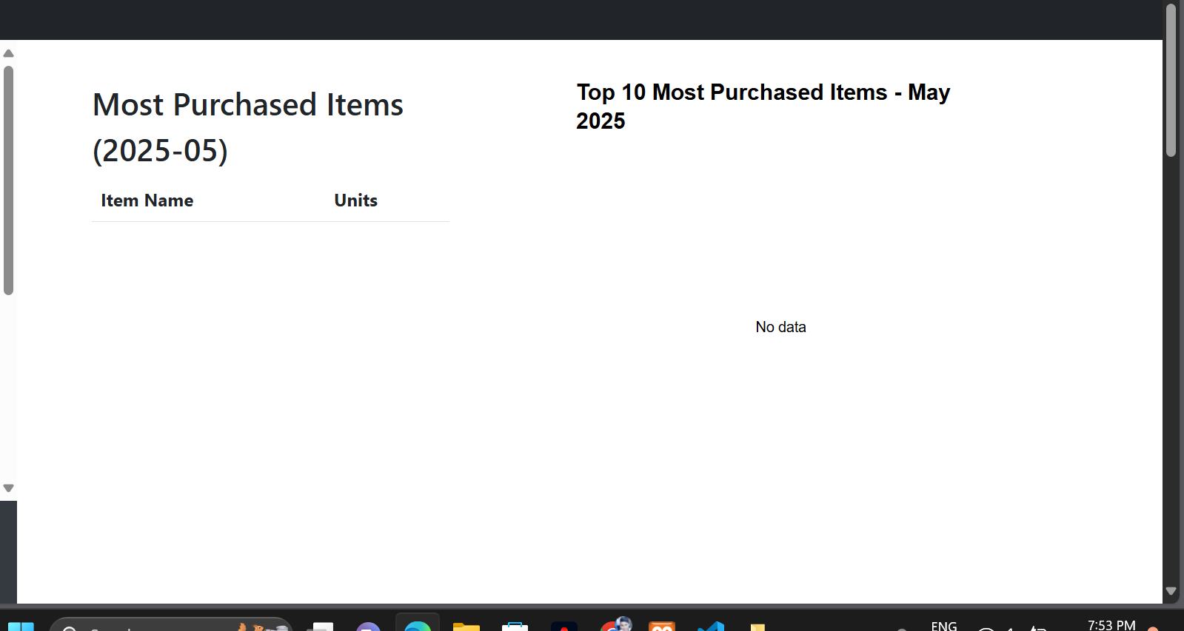
Annual Statistics Dashboard
Metrics:
Total revenue, top-selling items, table turnover, average order value
GRAPHS :
Pie chart, bar graph, line chart

Slide 10
Database Integration: Seamless Backend Operations
User Data
1
Store user profiles, preferences, and order history for personalized experiences and efficient management.
Menu Items
2
Maintain a comprehensive database of dishes, descriptions, ingredients, and pricing for accurate menu display.
Reservations & Orders
3
Track table bookings, manage orders, and process payments seamlessly, ensuring smooth operations.

Slide 11

Responsive and Accessible Design: A User-Friendly Experience
1
2
3
Cross-Platform Compatibility
Accessibility Features
User-Friendly Navigation
Ensure the website functions flawlessly across desktops, tablets, and mobile devices, providing a consistent experience.
Implement accessibility features, such as alt text for images and screen reader compatibility, to cater to all users.
Design a clear and intuitive navigation menu, allowing users to easily find the information they need.

